Slide 1
How to Use Ballots by Mail Envelopes
This is our interpretation, it is your responsibility to check with the Secretary of States office to verify. The information provided on this PowerPoint does not constitute legal advice; instead, all information and content available on this PowerPoint are for general informational purposes only.

Slide 2
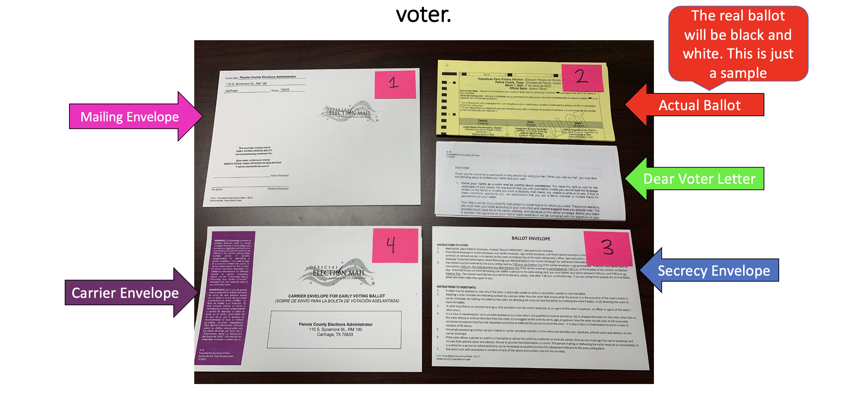
You should receive all of these items inside the mailing envelope (#1).
If you think you might be missing something please call us immediately!
Office Number 903-693-0370

Slide 3
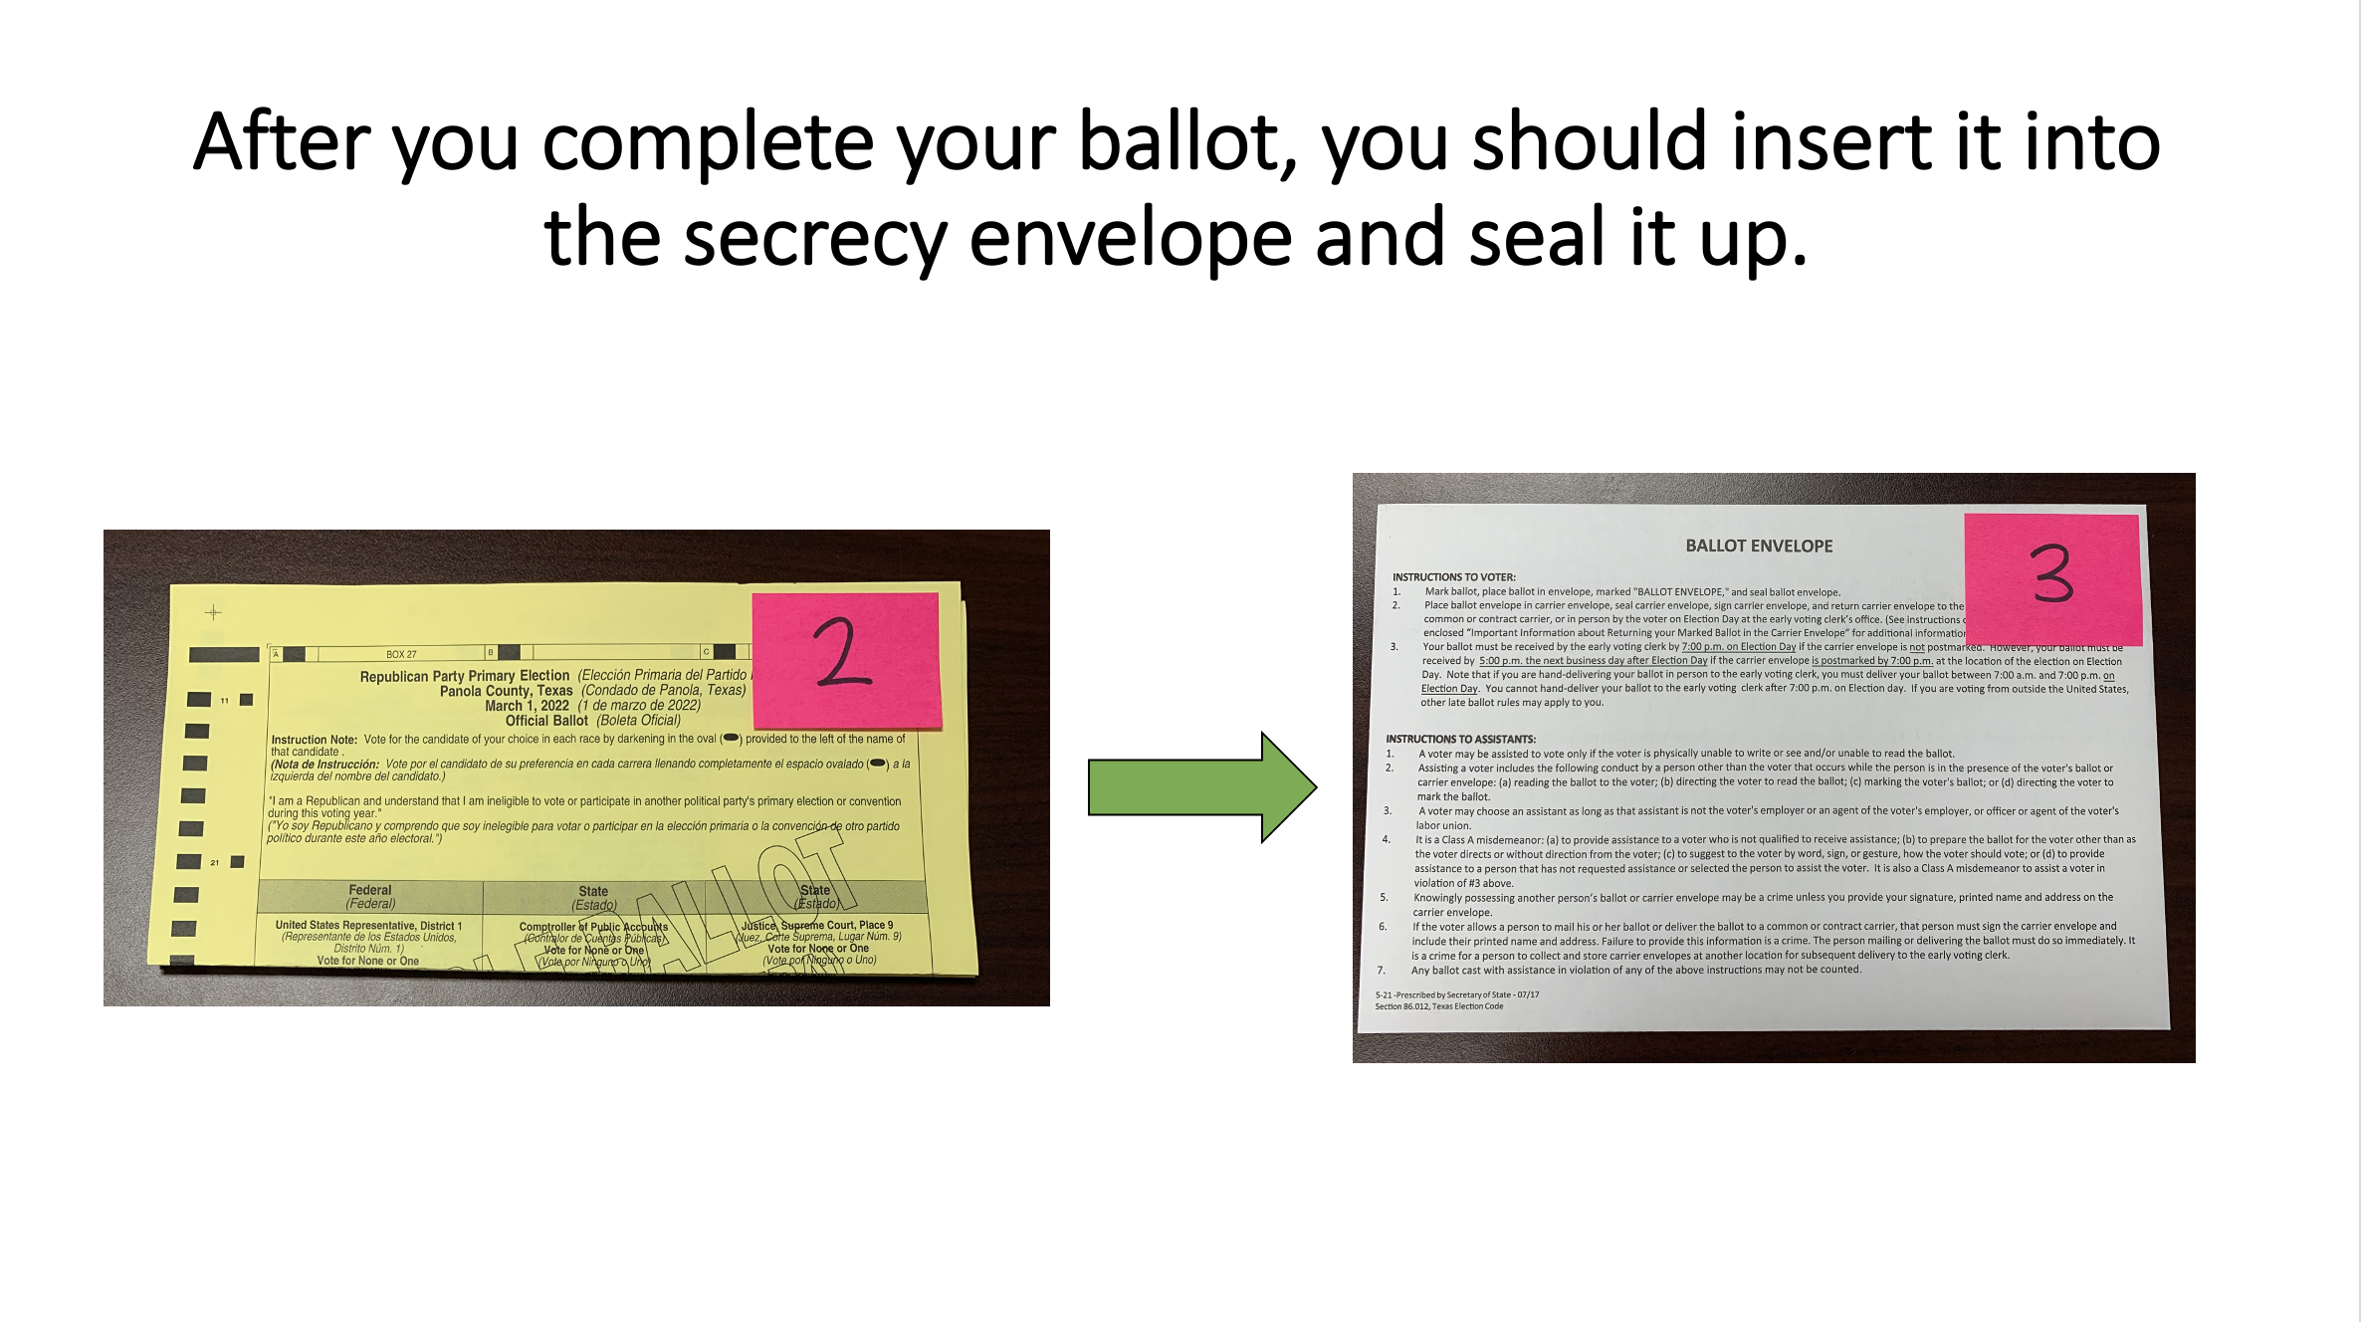

Slide 4
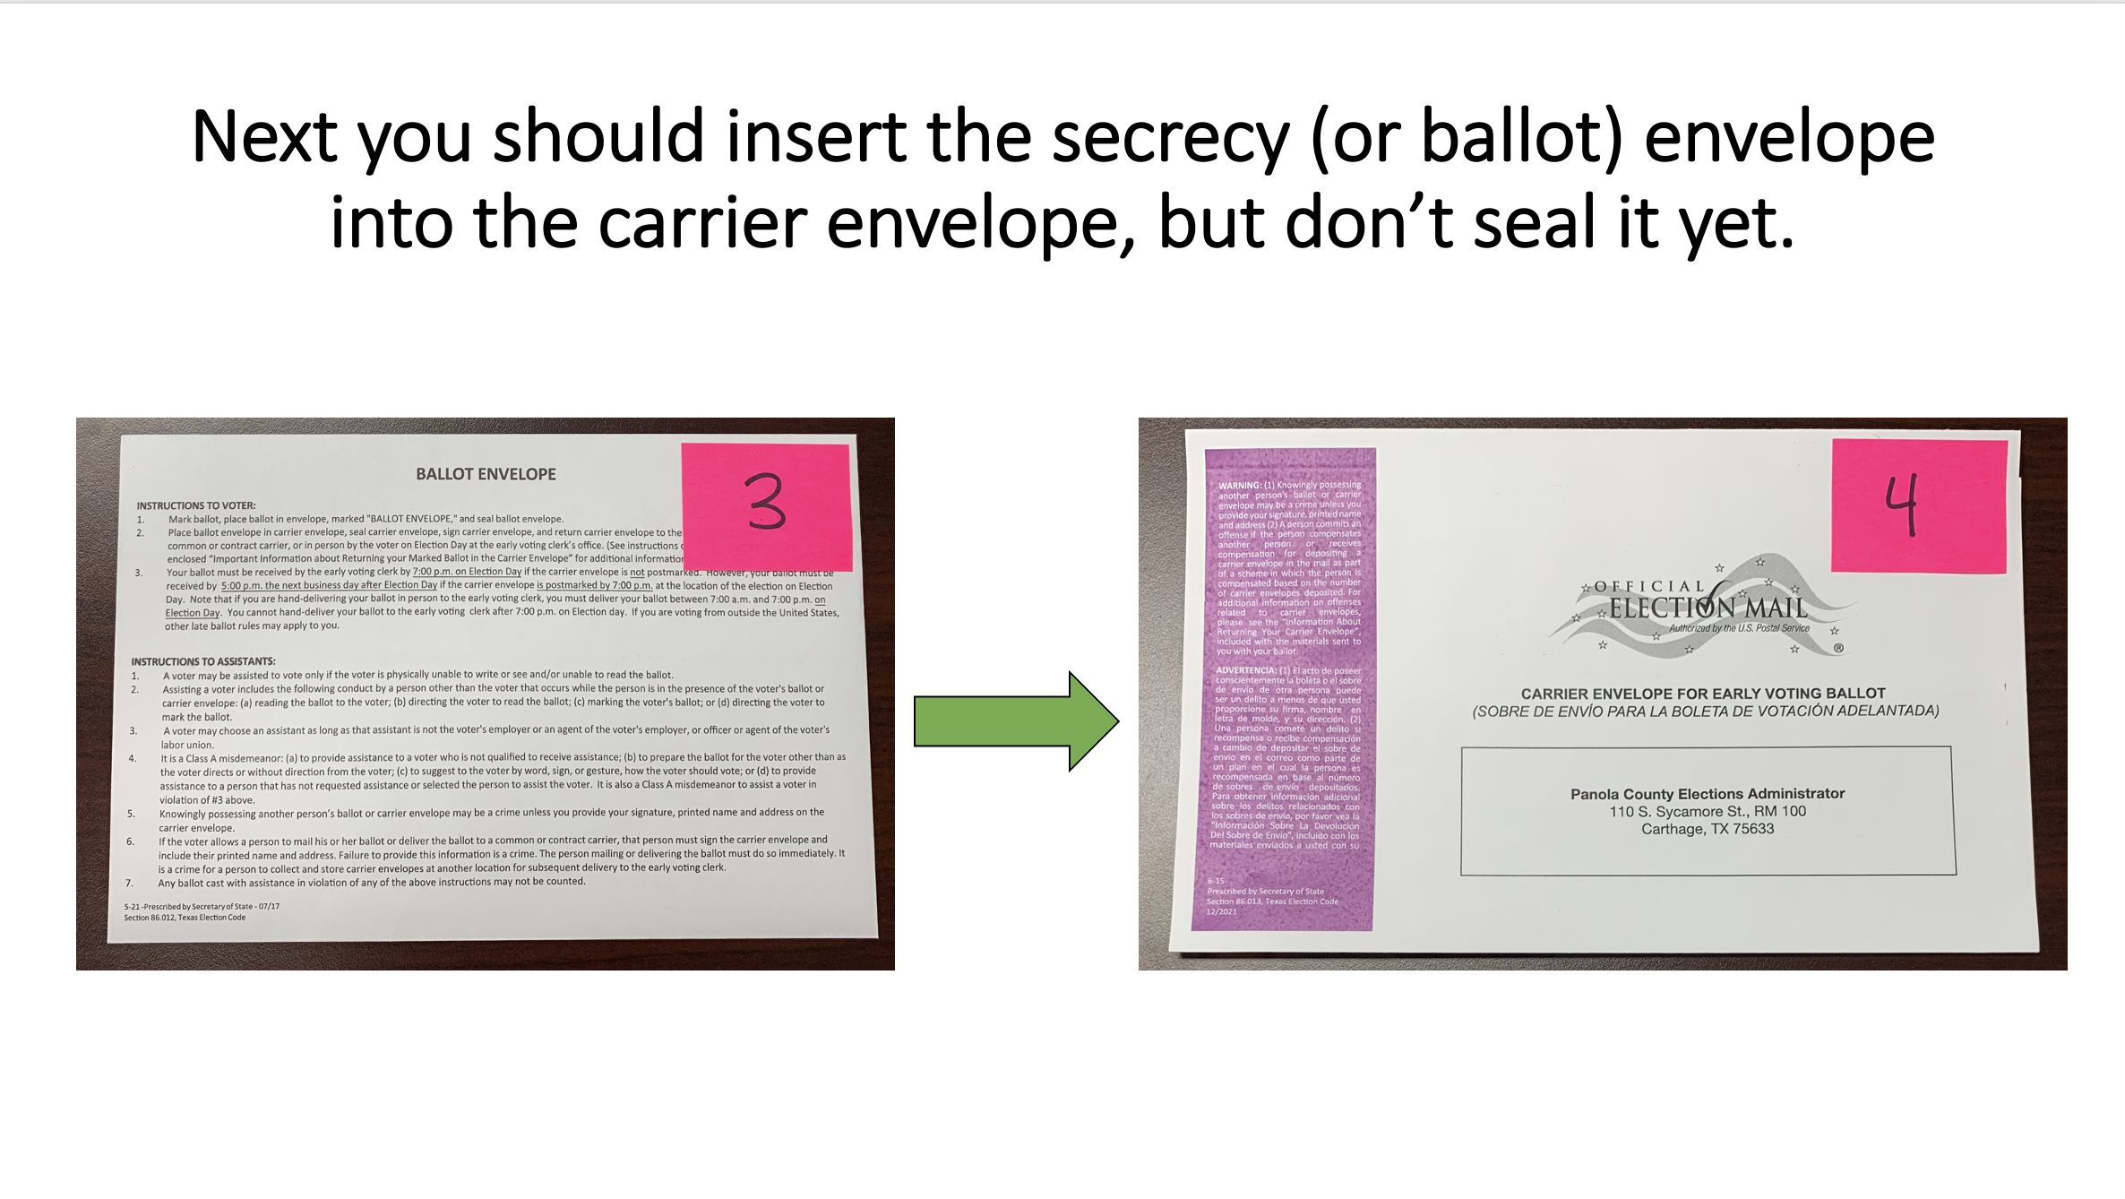

Slide 5
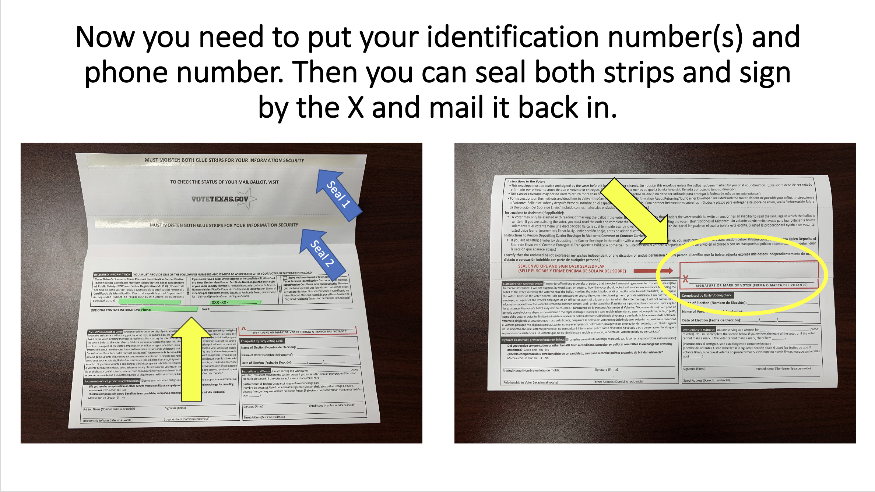
Kelseygates

Slide 6
Now What?
Now that you have voted your ballot and inserted it into the corresponding envelopes. You can mail your ballot back to us.
You cannot walk your ballot back into our office except on election day. And it must be delivered by the individual voter him/her self.
If you have any questions on how to properly mail back your ballot or to check the status of your ballot, please give us a call. Please remember we are very busy and will be happy to assist you as soon as possible!
Office Number: 903-693-0370

